Slide 1
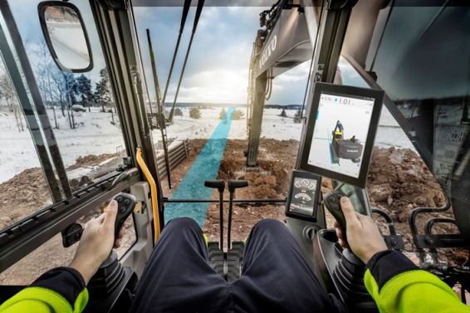
CoPilot driver statistics project
11/9/2016
Team members:
Vladimir Djukanovic
Leslie Dahlberg
Léa Brunschwig
Eric Engtorp
Fredrik Frenning
Pooria Ghavamian
Hamza Sabljakovic

Slide 2
Project description
Volvo Construction Equipment - The CoPilot
Android based tablet
CoPilot application (measuring time, speed, fuel consumption, load weight, and calculate a score that is used in a high score list).
App abilities: Present the current data and score to the driver. Access historic data through a backoffice server (cloud server). Publish current data in a web portal.

Slide 3
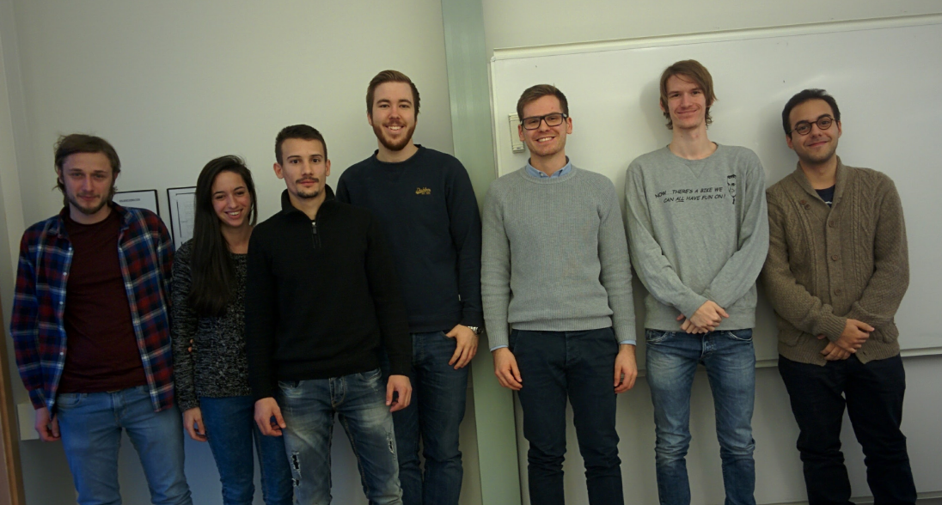
Team photo
Fredrik
Leslie
Erik
Pooria
Vlado
Lea
Hamza

Slide 4

Established
Meeting with client – Friday 11th 2016 at 12:15
Communication tool – slack
Project collaboration tool (board) – trello
Project hosting service (repo) – GitHub

Slide 5

Communication with client
After communication with client by email we established following statements:
Hardware is already developed (Volvo Co Pilot HW and cable harness)
Web service solution
Cloud hosting service - optional
Simulations via the Volvo simulators
Umeå
Västerås
Stockholm
Göteborg
Malmö

Slide 6
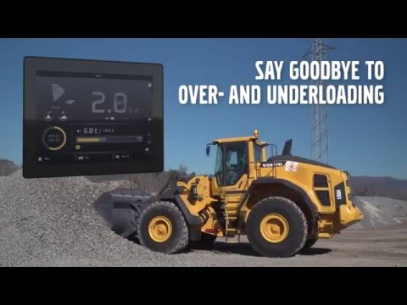
Following period
After official meeting with client, that is happening at following Friday 11^{th,} and establishing detailed requirements or ideas for project we are moving on requirements definition phase of project development.

